Slide 1
Session 2
Chapter 2 - Relational Model of Data - Part 1
Database Systems

Slide 2
Objectives
1
Understand what is a Data Model
2
Understand what belong to a Data Model
3
Understand what are Relations, Attributes, Tuples, Domains
4
Understand what are Relation instances, Schema, DB schema
5

Slide 3
Contents
1
An Overview of Data Models
2
Basics of the Relational Model
3

Slide 4
2.1. An Overview of Data Models

Slide 5
2.1.1. What is a Data Model?
A Data Model is a notation for describing data or information. The description generally consists of 3 parts:
  Structure of the data
  Operations on the data.
  Constraints on the data.

Slide 6
2.1.2.Important Data Models
Today, two important data models are:
The relational model, including object-relational extensions
The semi-structured data model, including XML and related standards

Slide 7
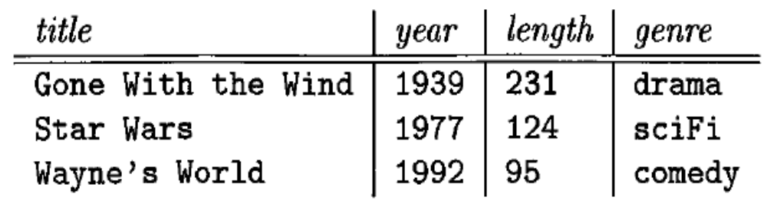
2.1.3. The Relational Model in Brief
The relational model is based on tables where:
  Column headers are field names
  Each row represents the values of one record
A relation of “Movies” data

Slide 8
2.1.4. The Semistructured Model in Brief
Semistructured data is based on trees or graphs, rather than tables or arrays.
The principal manifestation of this kind is XML: a way to represent data by hierarchically nested tagged elements where the tags are similar to column headers in the relational model.

Slide 9
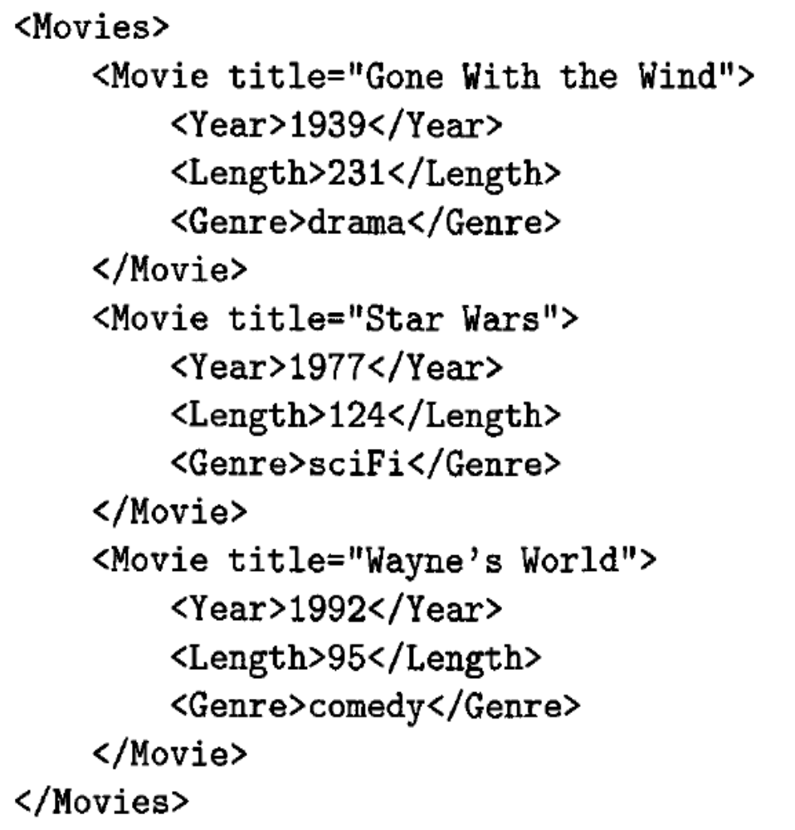
Movie data as XML

Slide 10
2.1.5. Other Data Models
Object-relational model:
  Values can have structure, rather than being elementary type such as string or integer.
  Relations can have associated methods.

Slide 11
2.2. Basics of Relational Model

Slide 12
2.2.1. Attributes
The relational model represents data as a 2-dimensional table (called a relation)
In the relation “Movies”:
  Each row represents a MOVIE
  Each column represent a property of MOVIES and also called a “attribute”

Slide 13
2.2.2. Schemas
The name of a relation and the set of attributes for that relation is called the schema for that relation, e.g.
MOVIES (title, year, length, genre)
The attributes in a relation schema are a set, not a list.
The set of schemas for the relations of a database is called a relational database schema, or just a database schema.

Slide 14
2.2.3. Tuples
A row of a relation is called a tuple (or record)
A tuple has one component for each attribute of the relation
When we want to write a tuple in isolation, not as part of a relation, we normally use commas to separate components.
E.g.: (Gone with the wind,1939, 231, drama)

Slide 15
2.2.4. Domains
The relational model requires that each component of each tuple must be atomic, that is, it must be of some elementary type such as INTEGER or STRING
It is not permitted for a value to be a record structure, set, list, array or any type that can have its values broken into smaller components
A Domain is a particular elementary type of a attribute, we could include the domain for each attribute in a relation schema as follows:

Slide 16
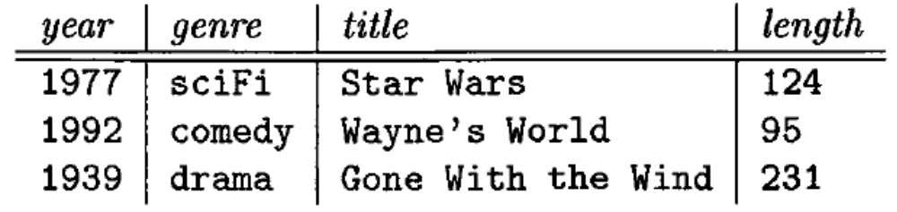
2.2.5. Equivalent representations of a relation
Relations are sets of tuples, not lists of tuples
So, the order in which the tuples of a relation are presented is not important
We can reorder the attributes of a relation without changing the relation
Another representation of relation “Movies”

Slide 17
2.2.6. Relation instances
A relation about Movies is not static but changing over time. We may want to:
  Insert tuples for new Movies, as these appear.
  Edit existing tuples if we get corrected information about a Movie.
  Delete a tuple from the database for some reason
A set of tuples for a given relation is called an instance of that relation
  The set of tuples that are in the relation “now” is called the current instance.

Slide 18
2.2.7. Keys of relations
A set of attributes forms a key for a relation if we don’t allow 2 tuples in a relation instance to have the same values in all the attributes of the key
  the relation Movies has a key consisting of the two attributes title and year.
We indicate attributes forming a key for a relation by underlining them
Movies (title, year, length, genre)

Slide 19
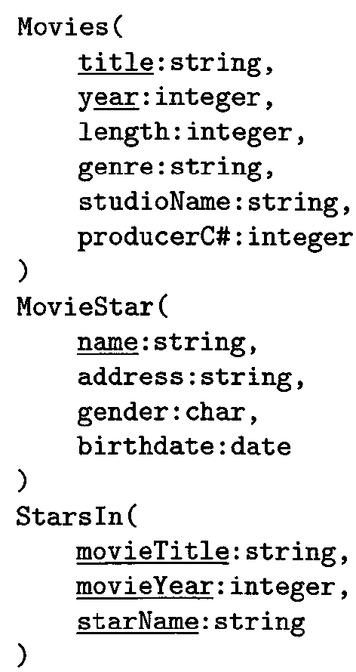
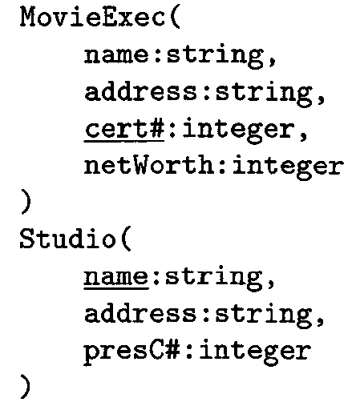
2.2.8. Example of database schema about movies

Slide 20
Summary 1: Relational Model
Table = relation.
Column headers = attributes.
Row = tuple
Relation schema = name(attributes) + other structure info.,
e.g., keys, other constraints. Example: Beers(name, manf)
  Order of attributes is arbitrary, but in practice we need to assume the order given in the relation schema.
Relation instance is current set of rows for a relation schema.
Database schema = collection of relation schemas.

Slide 21
Summary 2: Why Relations?
Very simple model.
Often a good match for the way we think about our data.
Abstract model that underlies SQL, the most important language in DBMS’s today.
  But SQL uses “bags” while the abstract relational model is set-oriented.

Slide 22
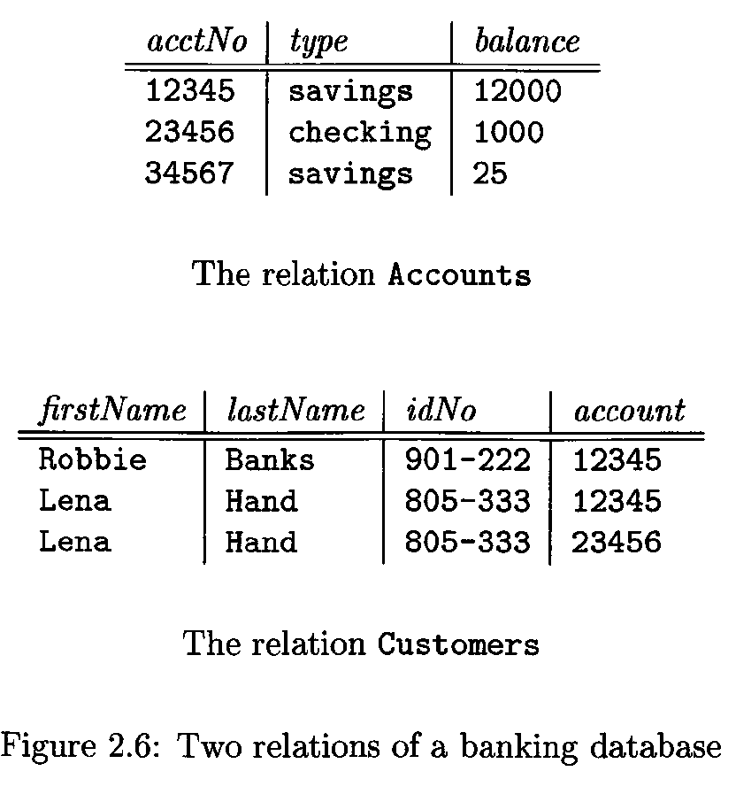
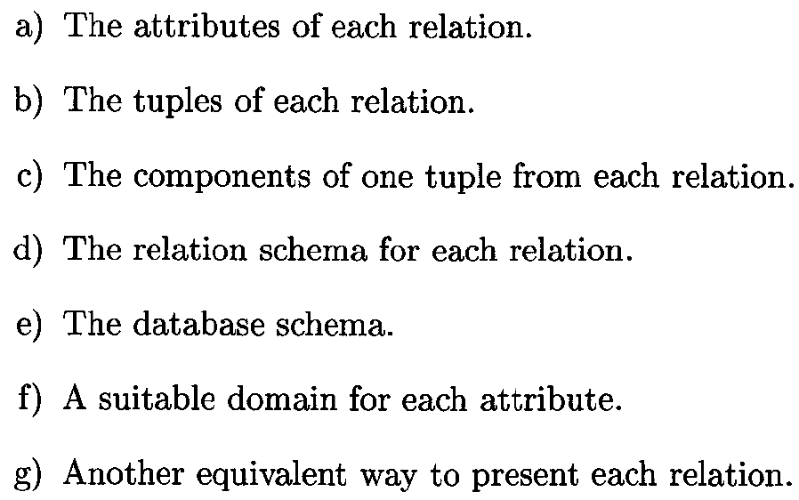
Exercises

Slide 23
Thank You !

